Slide 1

Module 5: Exception Handling

Slide 2
What is Exception?
→ Exception is an unwanted or unexpected event, which occurs during the execution of a program.
→ Exceptions can be caught and handled by the program.
→ When an exception occurs within a method, it creates an object. This object is called the exception object.
→ It contains information about the exception, such as the name and description of the exception and the state
of the program when the exception occurred.

Slide 3
Exception Handling
Java is one of the effective means to handle runtime errors so that the regular flow of the application can be preserved.
Java Exception Handling is a mechanism to handle runtime errors such as ClassNotFoundException, IOException, SQLException, RemoteException, etc.

Slide 4
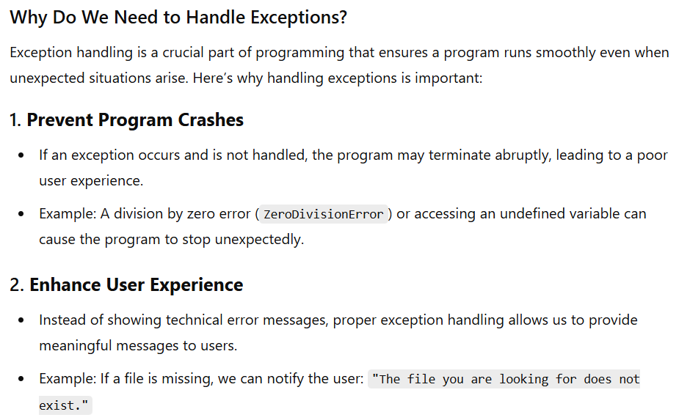

Slide 5
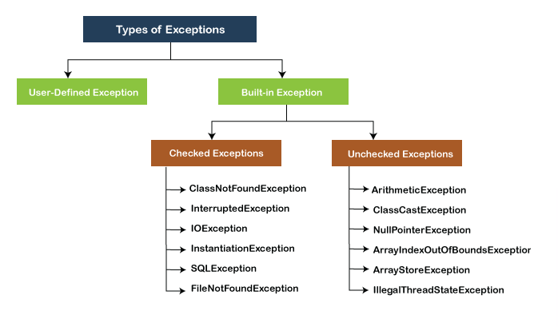
Types of Exception

Slide 6
Checked & Unchecked Exceptions
S No. | Checked Exception | Unchecked Exception
1. | Exceptions checked at compile time | Exceptions checked not at compile time
2. | They occur due to external factors | They occur due to logical mistakes or incorrect data

Slide 7
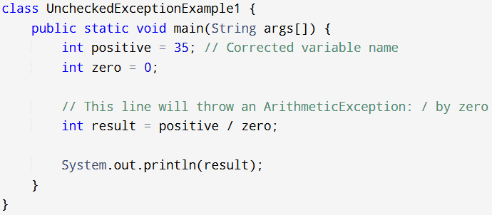
Unchecked Exception

Slide 8
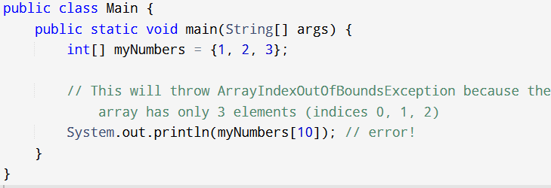
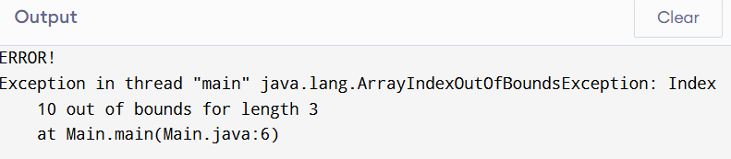

Slide 9
Exception Handling Keywords
Java exception handling is managed via five keywords:
Try
Catch
Finally
Throw
Throws

Slide 10
Java Exception Keywords
Keyword | Description
try | The "try" keyword is used to specify a block where we should place an exception code. It means we can't use try block alone. The try block must be followed by either catch or finally.
catch | The "catch" block is used to handle the exception. It must be preceded by try block which means we can't use catch block alone. It can be followed by finally block later.
finally | The "finally" block is used to execute the necessary code of the program. It is executed whether an exception is handled or not.
throw | The "throw" keyword is used to throw an exception.
throws | The "throws" keyword is used to declare exceptions. It specifies that there may occur an exception in the method. It doesn't throw an exception. It is always used with method signature.

Slide 11
Try and Catch
User-defined exception
It allows you to fix the error.
It prevents the program from automatically terminating.
To guard against and handle a run-time error, simply enclose the code that you want to monitor inside a try block.
Immediately following the try block, include a catch clause that specifies the exception type that you wish to catch.

Slide 12
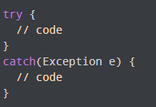
1. Try .. Catch block
Syntax

Slide 13
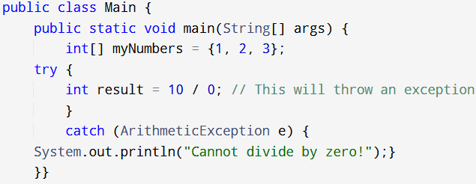


Slide 14
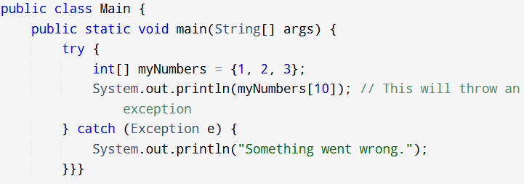

1. Try…. Catch

Slide 15
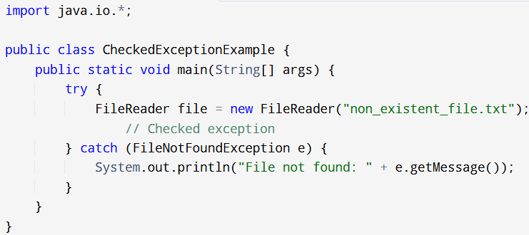


Slide 16
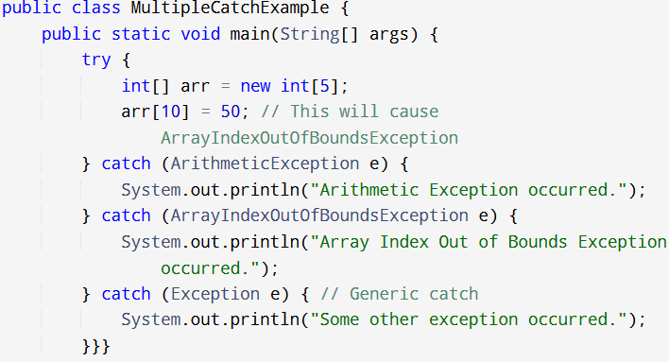


Slide 17
To handle the exception, we have put the code with the error inside the try block.
Now, when an exception occurs, the rest of the code inside the try block is skipped.
The catch block catches the exception, and statements inside the catch block are executed.
If none of the statements in the try block generates an exception, the
catch block is skipped.

Slide 18
2. finally
In Java, the finally block is always executed no matter whether there is an exception or not.
The finally block is optional. And, for each try block, there can be only one finally block.

Slide 19
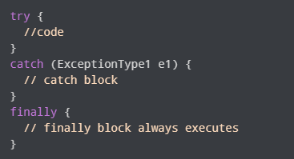
Syntax

Slide 20
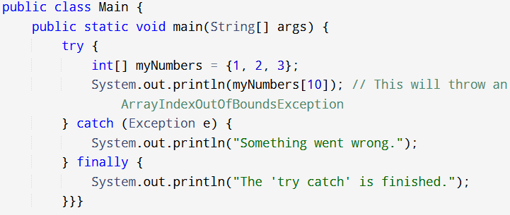
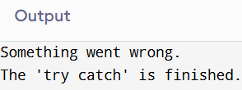

Slide 21
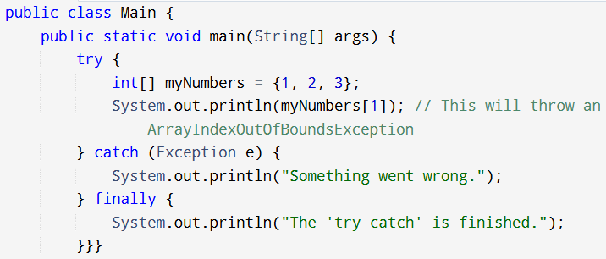
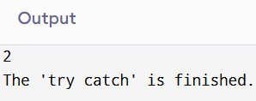

Slide 22
3. Throw
The Java throw keyword is used to explicitly throw a single exception.
When we throw an exception, the flow of the program moves from the try block to the catch block.
The throw statement allows you to create custom error.

Slide 23
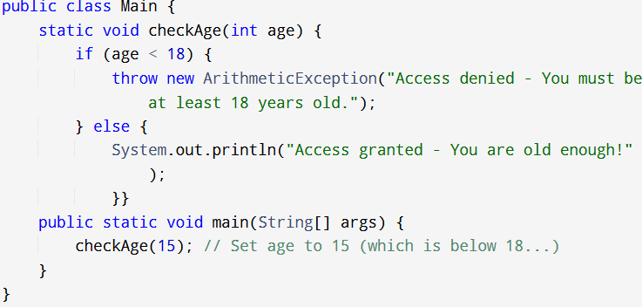
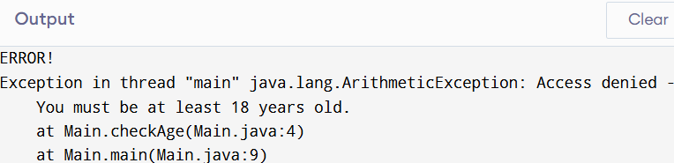

Slide 24

throws
We use the throws keyword in the method declaration to declare the type of exceptions
that might occur within it.

Slide 25
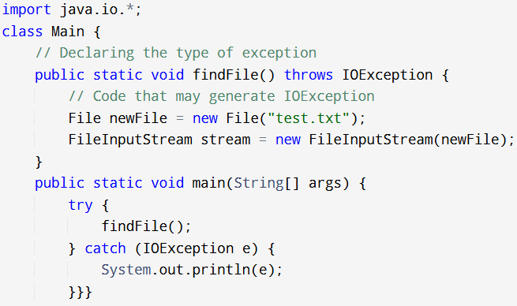

Example: Throws

Slide 26
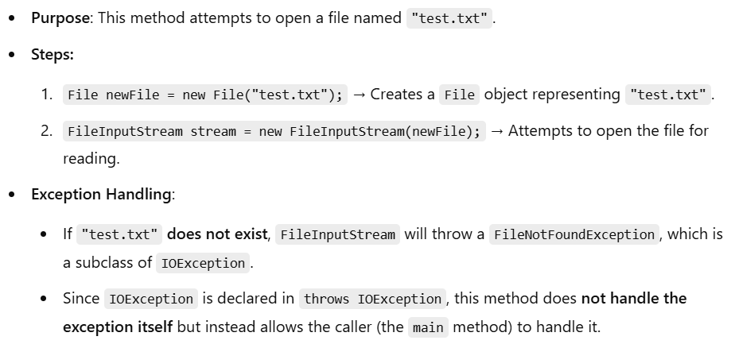

Slide 27
When we run this program, if the file test.txt does not exist, FileInputStream throws a FileNotFoundException
which extends the IOException class.
The findFile() method specifies that an IOException can be thrown.
The main() method calls this method and handles the exception if it is thrown.
If a method does not handle exceptions, the type of exceptions that may occur within it must be specified in the
throws clause.

